Slide 1
SPH Fluids in Computer Graphics
Markus Ihmsen - University of Freiburg
Jens Orthmann - University of Siegen
Barbara Solenthaler - ETH Zürich
Andreas Kolb - University of Siegen
Matthias Teschner - University of Freiburg

Slide 2
Topics / Research Challenges
SPH fluid solver
Neighborhood query
Incompressibility / pressure computation
Boundary handling
Multiple phases
Multi-resolution
Surface reconstruction and rendering

Slide 3
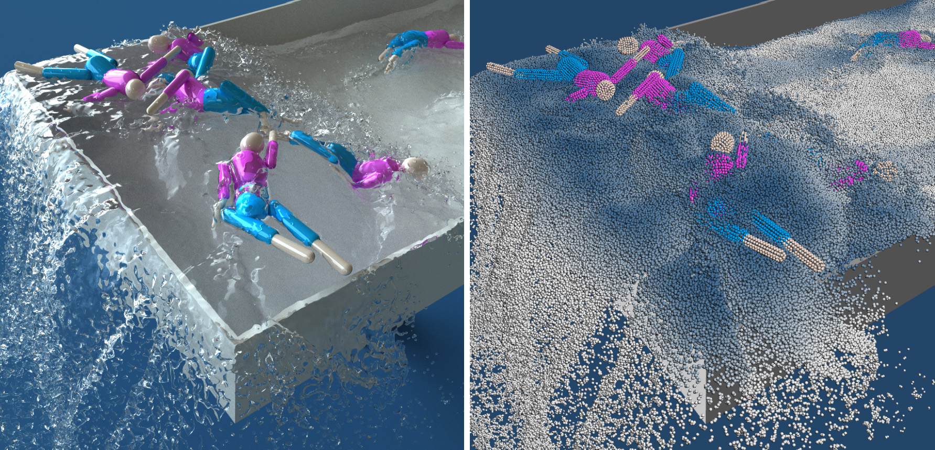
Concept

Slide 4
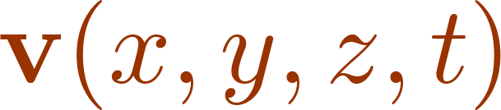






Lagrangian Approach
flow properties are considered at irregular positions
particles have volume , mass , density , pressure
particles move with their velocity

Slide 5
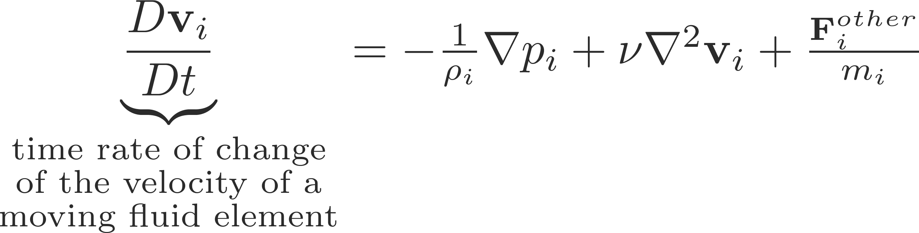

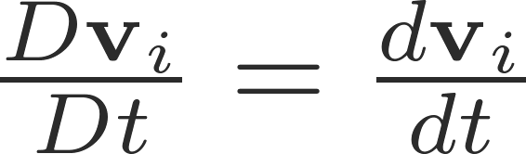
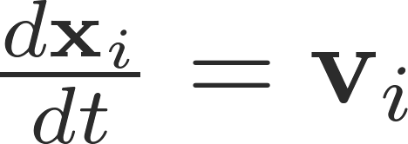

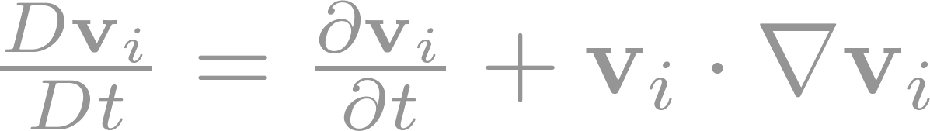
Momentum Equation
Navier-Stokes
Lagrangian form with advected fluid samples / particles
Eulerian form with fixed fluid samples
Accounts for the missing
movement of the sample

Slide 6
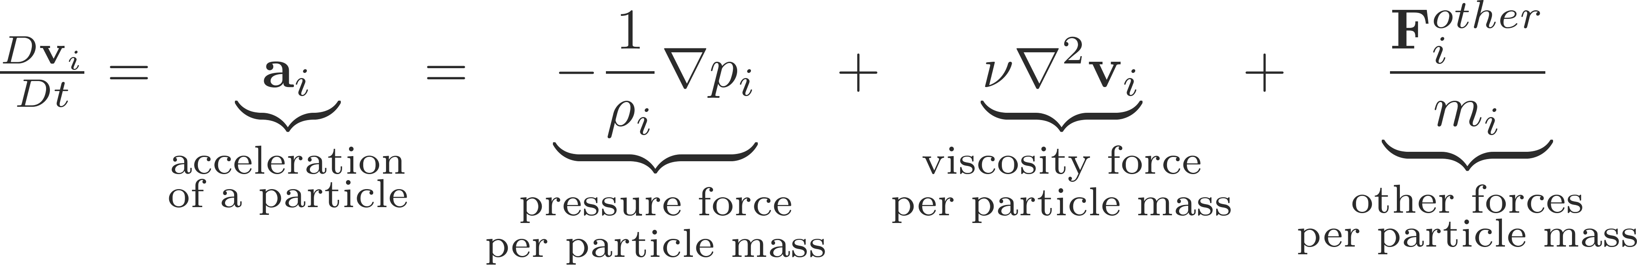
Momentum Equation
Navier-Stokes
Pressure
  Acceleration due to pressure differences
  Preserves the fluid volume / density
Viscosity
  Acceleration due to friction between particles with different velocities
Other
  Gravity
  Acceleration due to boundary handling

Slide 7
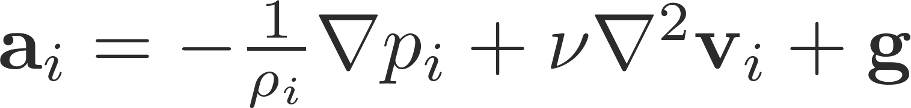
Smoothed Particle Hydrodynamics SPH
Interpolation method
  Proposed by Gingold and Monaghan (1977) and Lucy (1977)
Can be used for sets of arbitrary samples to
  Interpolate quantities
  Approximate spatial derivatives
SPH in a Lagrangian fluid simulation
  Fluid is represented with a set of particles / samples
  SPH is used to discretize

Slide 8
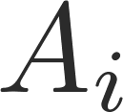


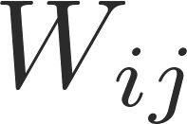
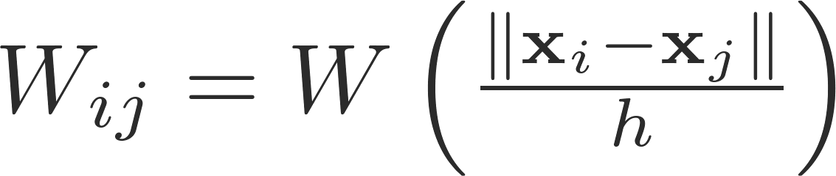

Interpolation with SPH
Quantity at arbitrary position is approximately computed with a set of known quantities at sample positions
  is not necessarily a sample position
  If is a sample position, it contributes to the sum
is a kernel function that weights the contributions
of sample positions according to their distance to
  is the so-called smoothing length
  is not necessarily the particle distance
  or the size of the compact support of

Slide 9

Kernel Function
Close to a Gaussian, but with compact support
Number of neighboring particles considered in the interpolation
  Depends on dimensionality, kernel support, particle spacing / mass
  In 3D, 30-40 neighboring particles are recommended
  E.g., cubic spline, support , particle spacing
  Trade-off between performance and interpolation accuracy

Slide 10
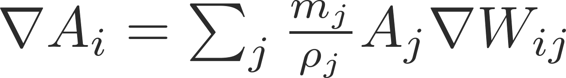
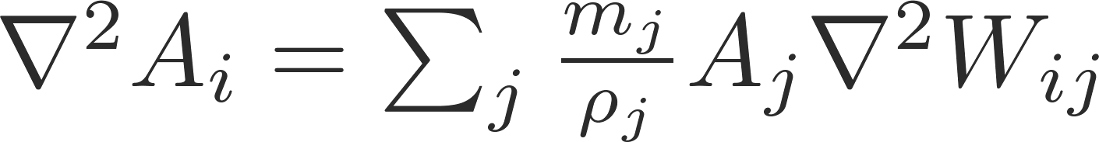
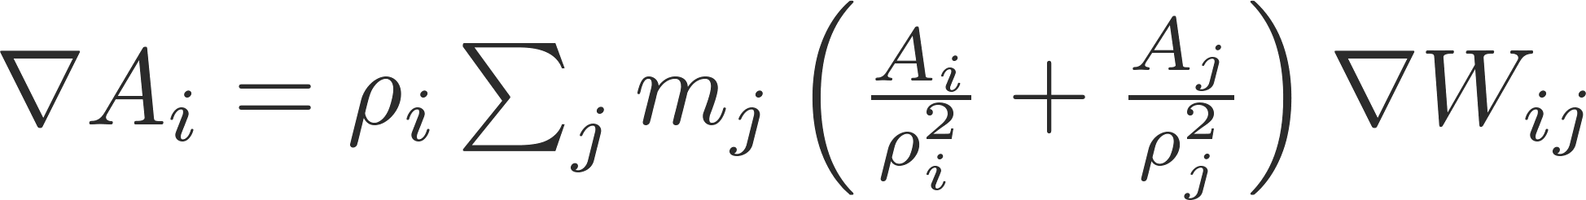
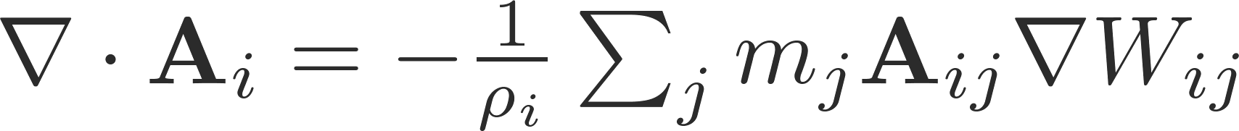
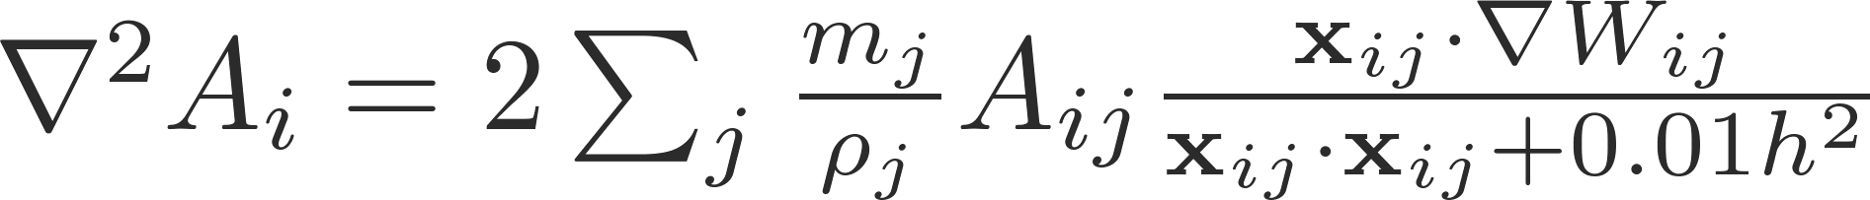
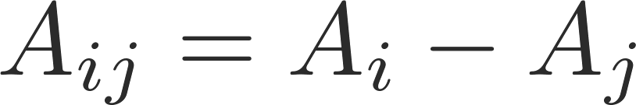


Spatial Derivatives with SPH
Original approximations
Currently preferred approximations
Preserves linear and
angular momentum
Sampling independent
More robust as it avoids
the second derivative of W

Slide 11
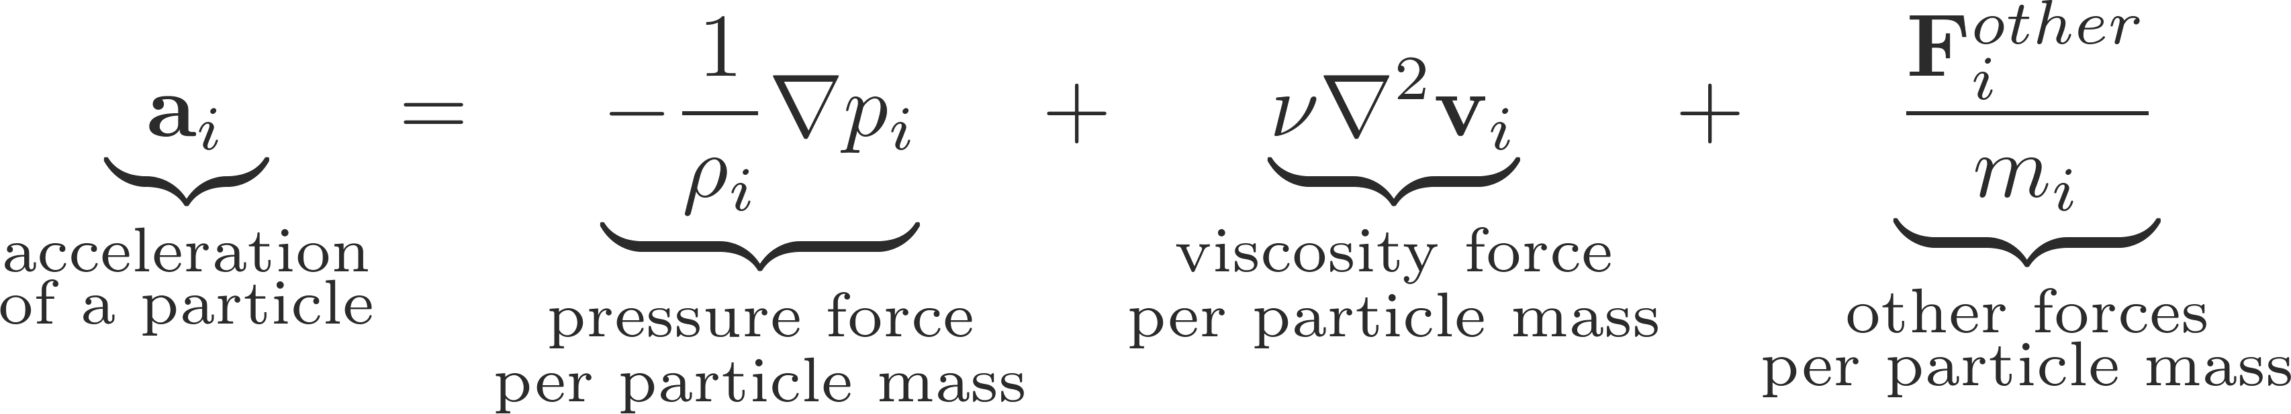
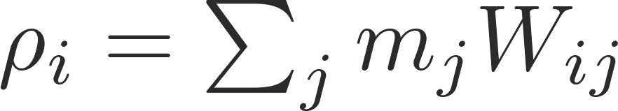
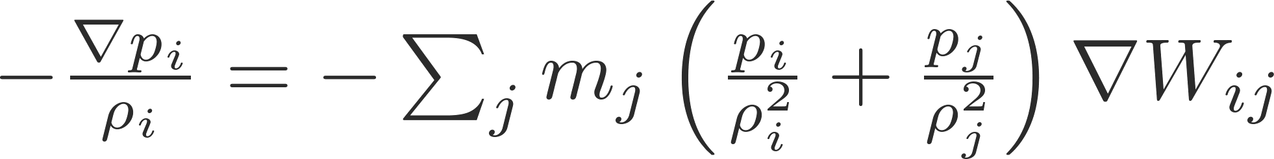
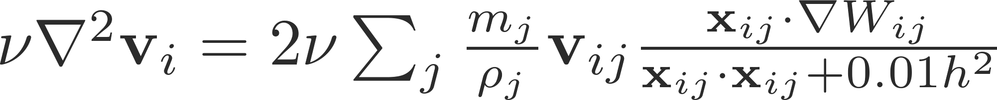
Momentum Equation – SPH Discretization
Navier-Stokes
Density
Pressure acceleration
Viscosity acceleration
Notes:
11

Slide 12


Simple SPH Fluid Solver
Find all neighbors of particle
Compute density
Compute pressure
Compute accelerations
Update velocity and position

Slide 13
Topics / Research Challenges
SPH fluid solver
Neighborhood query
Incompressibility / pressure computation
Boundary handling
Multiple phases
Multi-resolution
Surface reconstruction and rendering

Slide 14
Neighbor Search
For the computation of SPH sums, each particle needs to know 30-40 neighbors in each simulation step
Current scenarios
  Up to 100 million fluid particles
  Up to 3 billion neighbors per simulation step
Efficient construction and processing of dynamically changing neighbor sets is essential

Slide 15
Characteristics
SPH computes sums
  Dynamically changing sets of neighboring particles
  Temporal coherence
Spatial data structures accelerate the neighbor search
  Fast query
  Fast generation - each simulation step
  sparsely, non-uniformly filled simulation domain
Similarities to collision detection and intersection tests in raytracing
  However, cells adjacent to the cell of a particle have to be accessed

Slide 16
Characteristics
Uniform grid
  E.g., [Mueller03, Harada07, Green08, Goswami11, Ihmsen11, Macklin13]
  Generally preferred - construction in O(n), access in O(1)
Hierarchical data structures
  E.g., [Vermuri98, Keiser06, Adams07]
  Less efficient - construction in O(n log n), access in O(log n)
Verlet lists
  E.g., [Verlet67, Hieber07]
  Potential neighbors computed within larger distance than actual support
  Potential neighbors updated every n-th simulation step
  Memory-intensive and slow

Slide 17
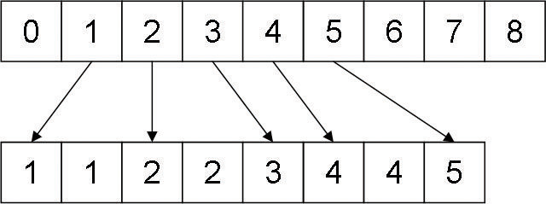
Index Sort – Uniform Grid
Cell index c = k + l · K + m · K · L is computed for a particle
  K and L denote the number of cells in x and y direction
Particles are sorted with respect to their cell index
  e.g., radix sort, O(n)
Each grid cell ( k, l, m ) stores a reference to the first particle in the sorted list
uniform grid
sorted particles with
their cell indices

Slide 18
Index Sort – Query
Sorted particle array is queried
Particles in the same cell are queried
References to particles of adjacent cells are obtained from the references stored in the uniform grid
Cache-hit rate
  Particles in the same cell are close in memory
  Particles of neighboring cells are not necessarily close in memory

Slide 19
Z-Index Sort
Particles are sorted with
respect to z-curve index
Improved cache-hit rate
  Particles in adjacent cells
  are close in memory
Efficient computation of
z-curve indices possible
z-curve

Slide 20
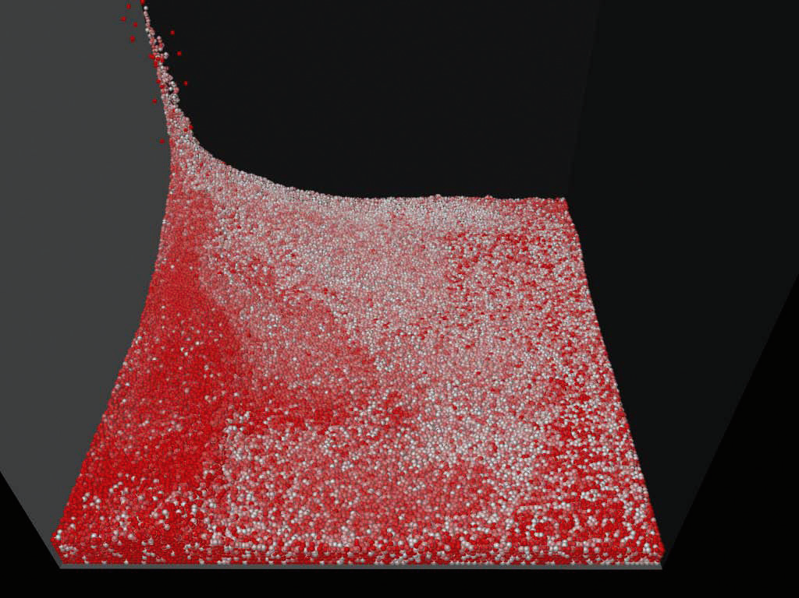
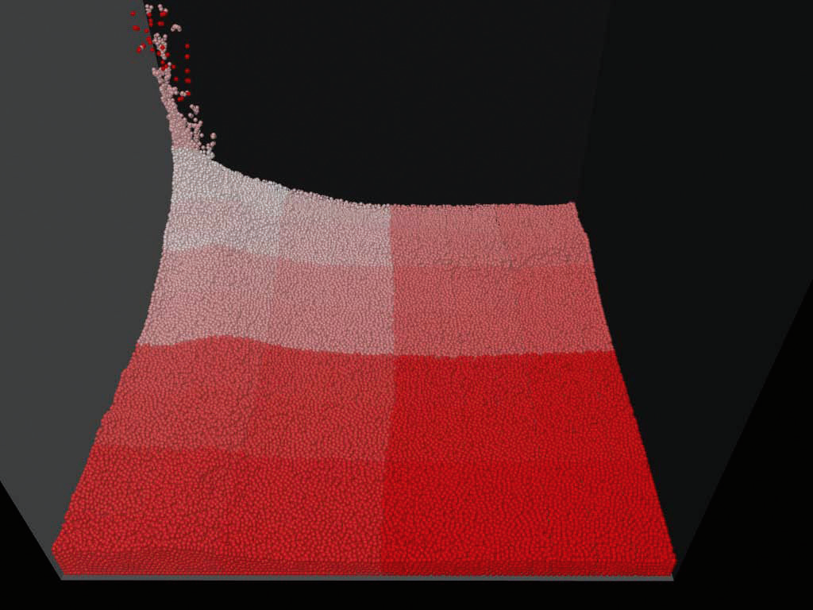
Z-Index Sort - Reordering
Particles colored according
to their location in memory
Spatial compactness is
enforced using a z-curve

Slide 21
Topics / Research Challenges
SPH fluid solver
Neighborhood query
Incompressibility / pressure computation
Boundary handling
Multiple phases
Multi-resolution
Surface reconstruction and rendering

Slide 22
Pressure Computation
Role of pressure forces
  Counteracts volume compression
  Acceleration due to pressure differences
Incompressibility
  Is essential for a realistic fluid behavior
  Inappropriate compression leads, e.g., to oscillations at the free surface
  Is computationally expensive:
    Simple computations require small time steps
    Large time steps require complex computations

Slide 23
Pressure Computation - Models
Non-iterative state-equation-based
  Compressible [Müller03]
  Weakly-compressible [Becker07]
Iterative state-equation based
  PCISPH [Solenthaler09]
  Local Poisson SPH [He12]
  PBF [Macklin13]
Pressure projection
  Divergence free [Cummins99]
  Density invariant [Shao03]
  IISPH [Ihmsen13]

Slide 24
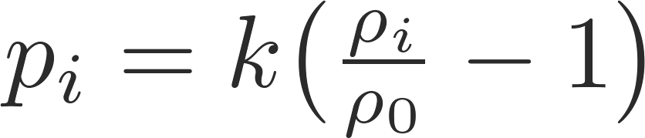
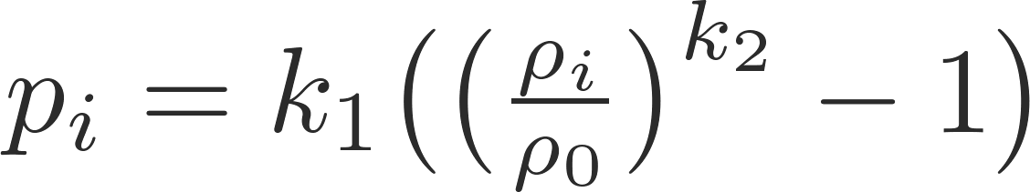

State Equations (EOS, SESPH)
Pressure is locally computed from density, e.g.,
  Compressible SPH
  Weakly compressible SPH
  Stiffness constants are user-defined
Penalty approach
  Current density fluctuations result in density gradients
  Density gradients result in pressure gradients
  Pressure gradients result in pressure force from high to low pressure
Properties
  Fast computation, but small time steps
  Stiffness constant govern compressibility
  Stiffness restricts the time step (scenario dependent)

Slide 25
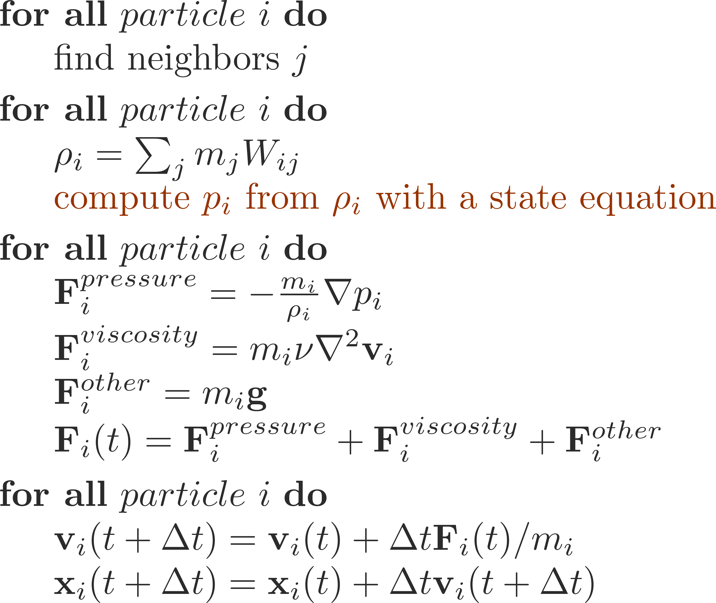
Non-iterative EOS Solver (SESPH)

Slide 26
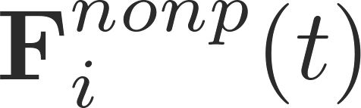
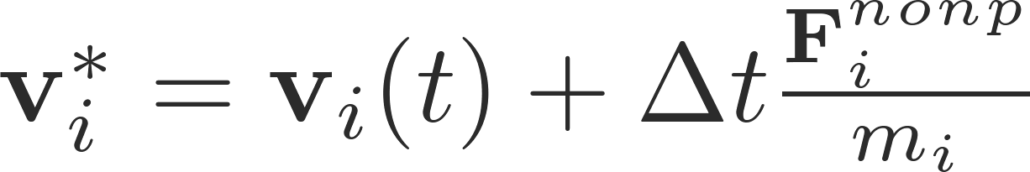
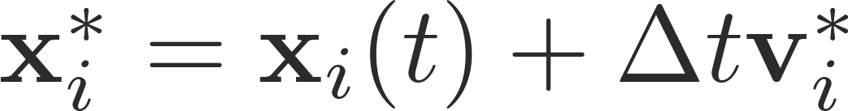
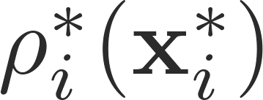

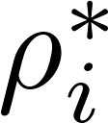
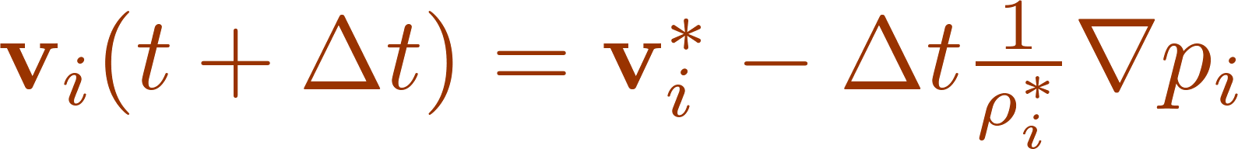
SESPH with Splitting
Compute pressure after advecting particles with non-pressure forces
Splitting concept
  Compute all non-pressure forces
  Compute intermediate velocity
  Compute intermediate position
  Compute intermediate density
  Compute pressure from intermediate density using an EOS
  Compute final velocity
Motivation
  Consider competing forces
  Take (positive or negative) effects of non-pressure forces
  into account when computing the pressure forces

Slide 27
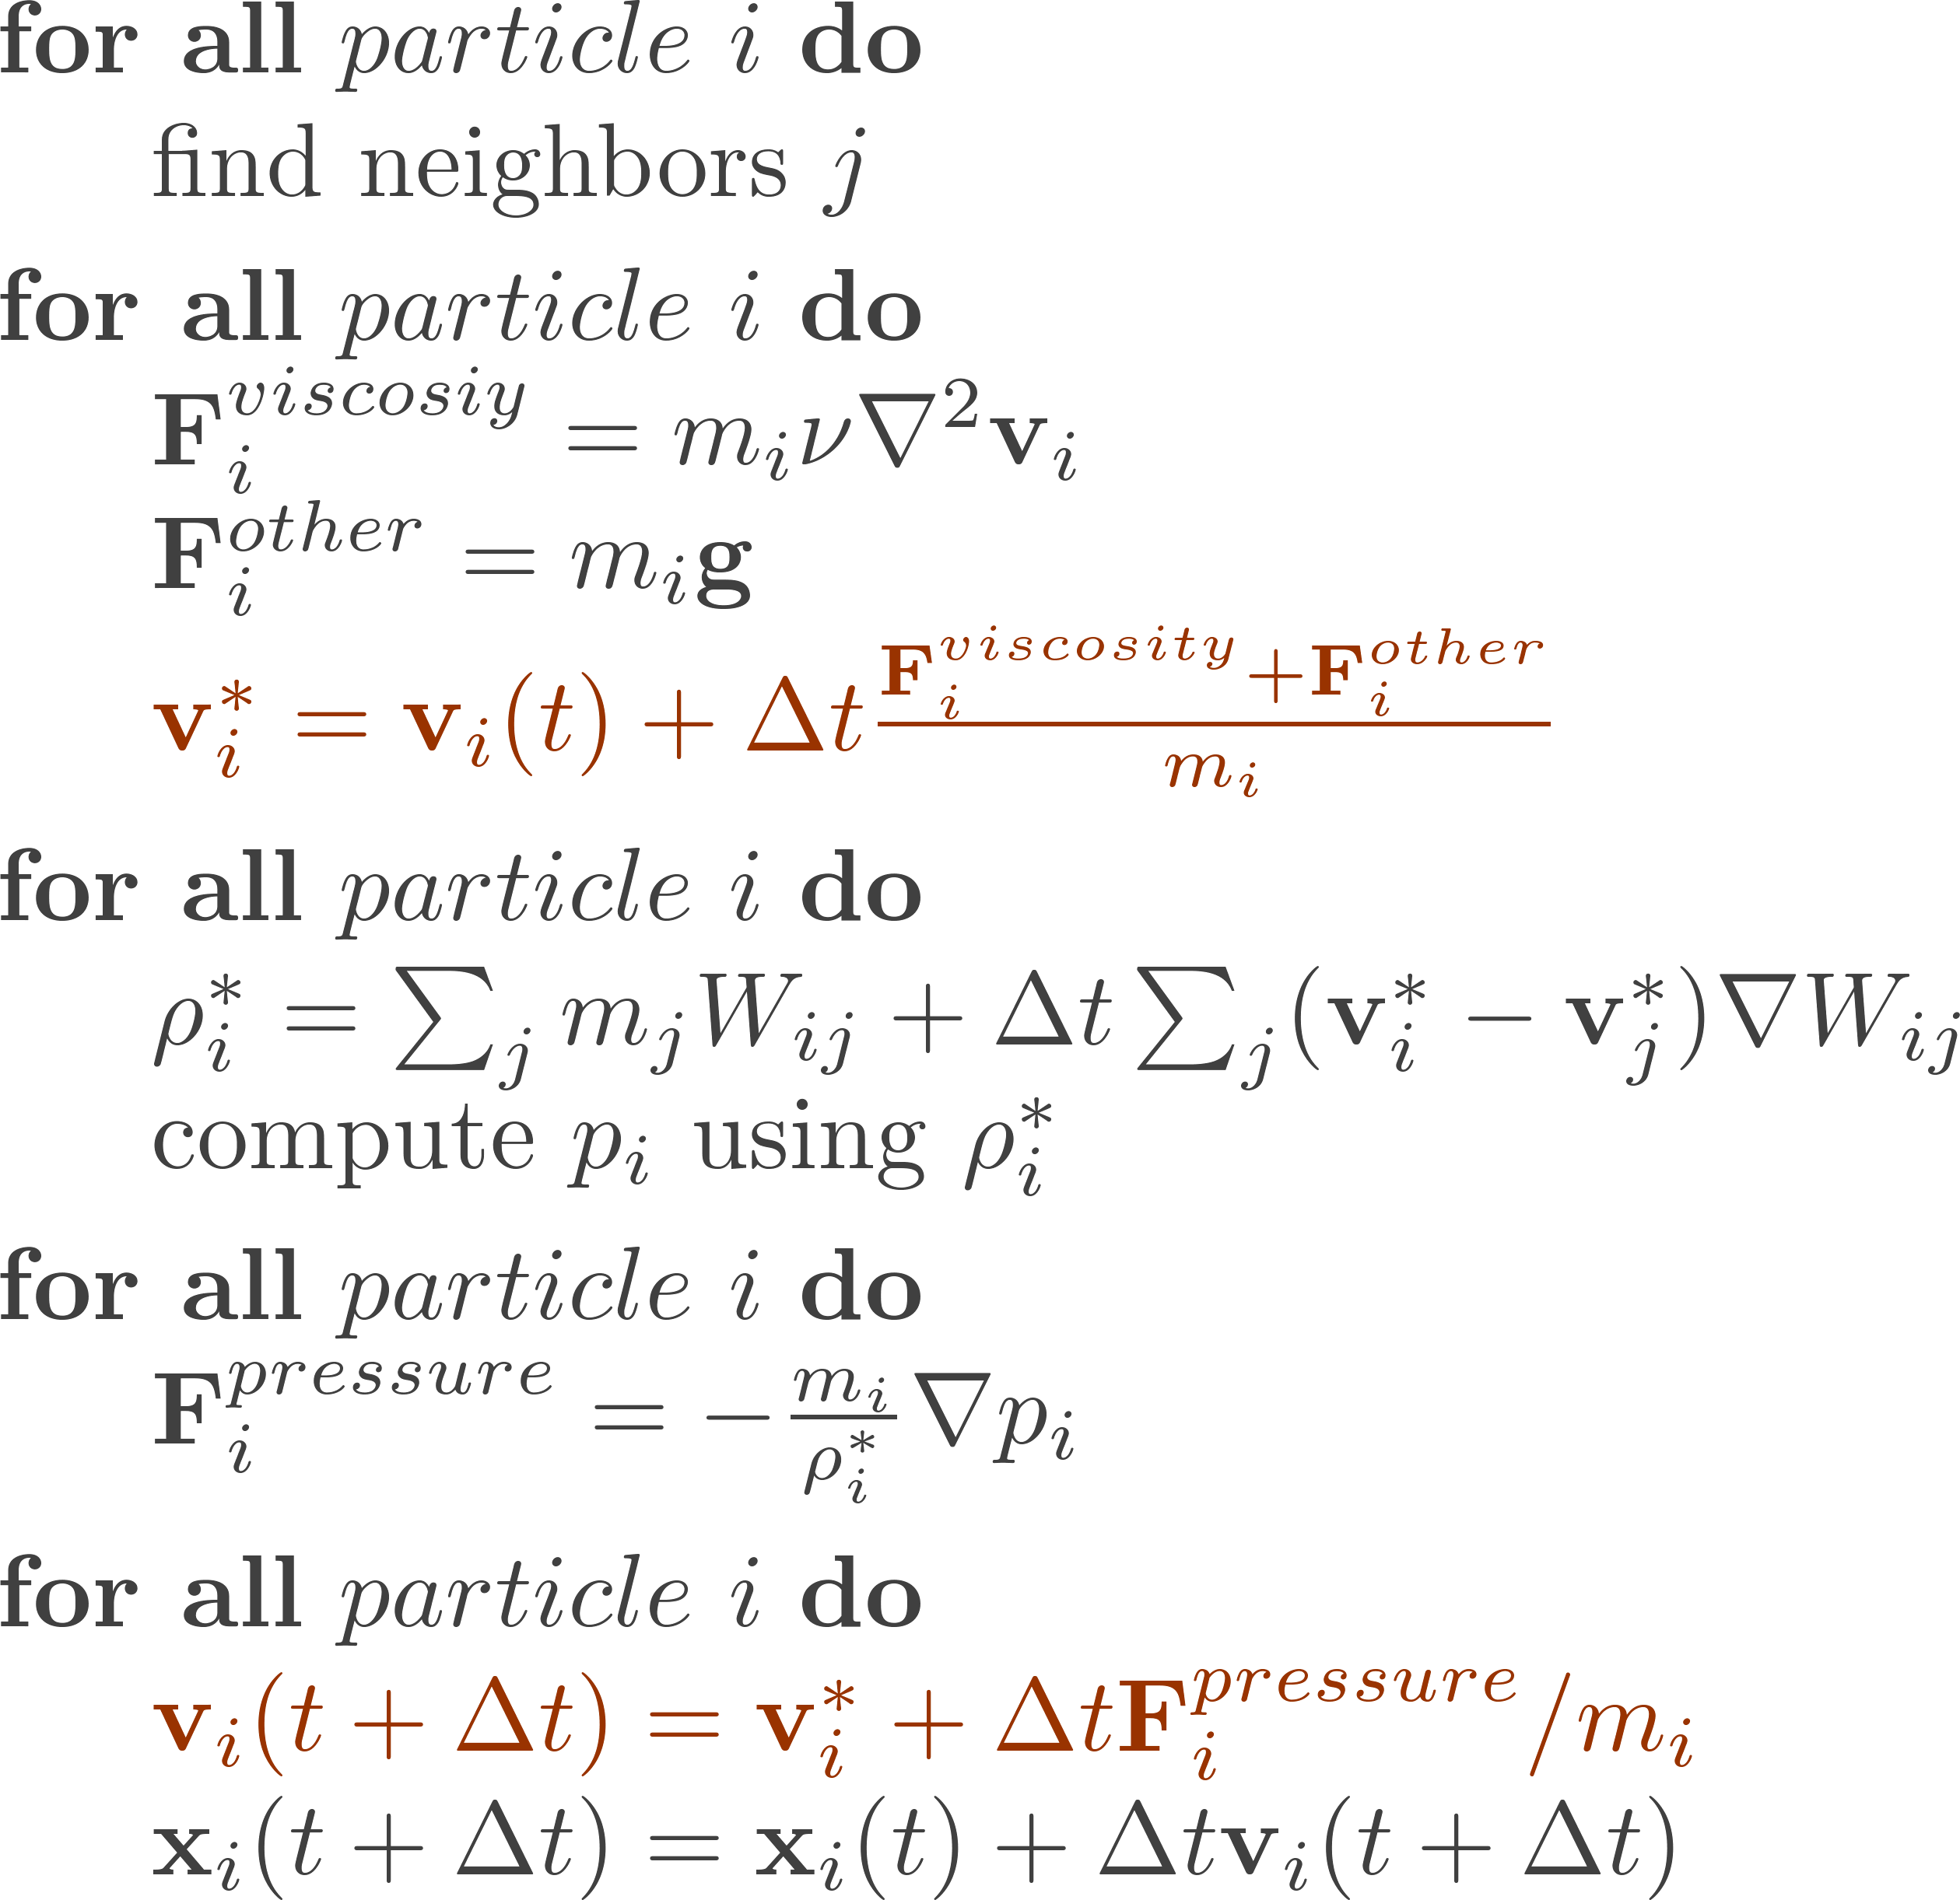
SESPH with Splitting
- follows from the continuity equation
- avoids neighbor search

Slide 28
Iterative SESPH with Splitting
Pressure forces are iteratively accumulated and refined
Concept
  Compute non-pressure forces, intermediate velocity and position
  Iteratively
    Compute intermediate density from intermediate position
    Compute pressure from intermediate density
    Compute pressure forces
    Update intermediate velocity and position
Motivation
  Parameterized by a desired density error, not by a stiffness constant
  Provides a fluid state with a guaranteed density error

Slide 29
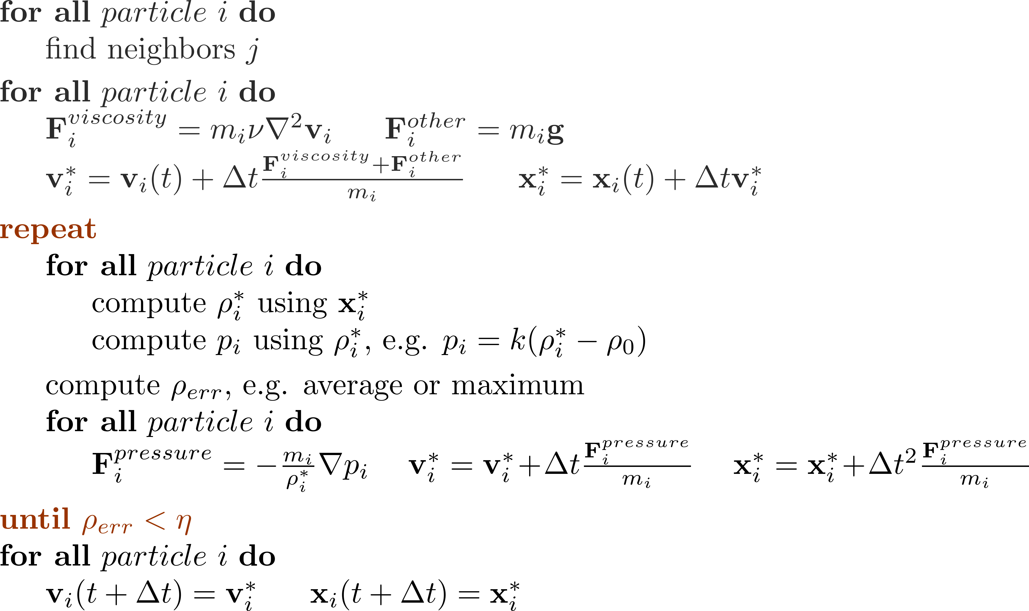
Iterative SESPH with Splitting
user-defined density error

Slide 30
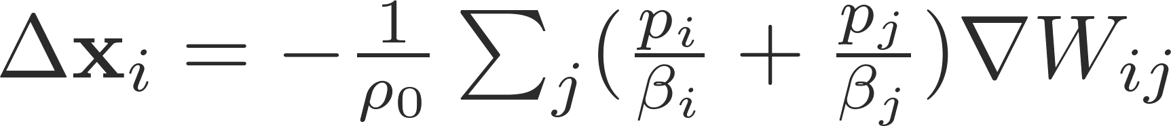
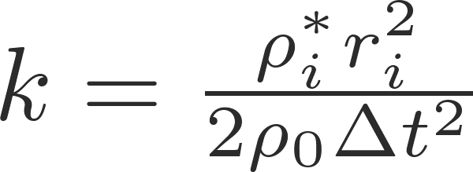

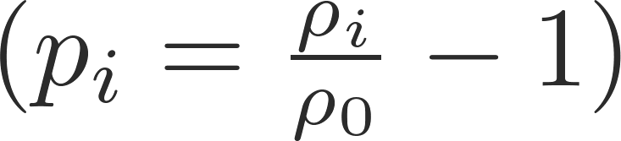
Iterative SESPH - Variants
Different quantities are accumulated
  Pressure forces (local Poisson SPH)
  Pressure (predictive-corrective SPH, PCISPH)
  Distances (position-based fluids, PBF)
Different EOS and stiffness constants are used
  Local Poisson SPH:
  PCISPH:
  PBF:
β is a pre-computed constant

Slide 31
Iterative SESPH - Performance
Typically 3-5 iterations for density errors between 0.1% and 1%
Typical speed-up over non-iterative SESPH: 50
  More computations per time step compared to SESPH
  Significantly larger time step than in SESPH
EOS and stiffness constant influence the number of
required iterations to get a desired density error
  Rarely analyzed
Non-linear relation between time step and iterations
  Largest possible time step does not necessarily lead to an optimal overall performance

Slide 32
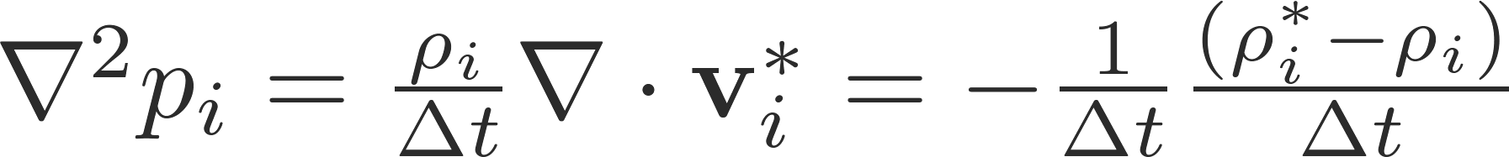
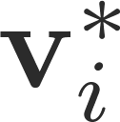

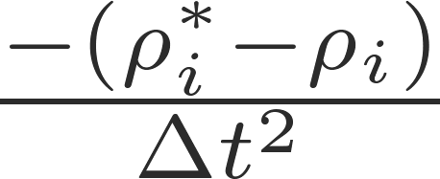
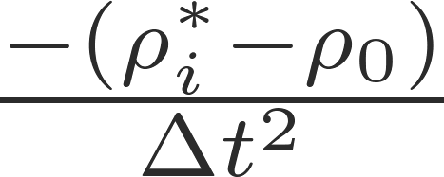
Projection Schemes
Compute pressure with a pressure-Poisson equation
  : predicted velocity considering all non-pressure forces
  : predicted density with respect to , e.g.,
Source terms:
  : divergence-free condition, e.g., [Cummins99]
  : density invariance condition , e.g., [Shao03, IISPH]

Slide 33
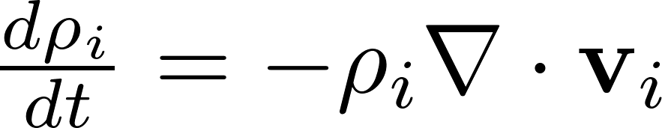
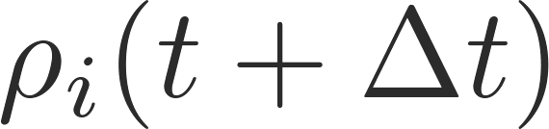

IISPH - Method
Continuity equation
SPH discretization
  Constrain to reference density
  Velocities are unknown
Notes:
Vorbedingung ist, dass die Masse der Partikel konstant ist. Wir wollen, dass das Volumen eines Partikels über die Zeit auch constant ist und das ist der Fall wenn die Dichte eines Partikels constant bleibt. Die Dichteänderung lässt sich über die Kontinuitätsgleichung über die Divergenz der Geschwindigkeit beschreiben

Slide 34
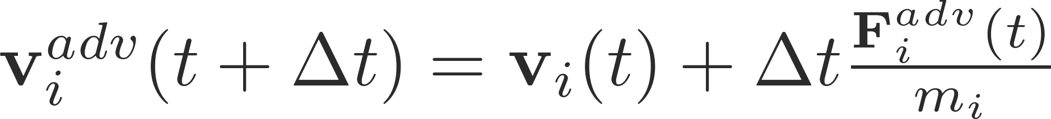
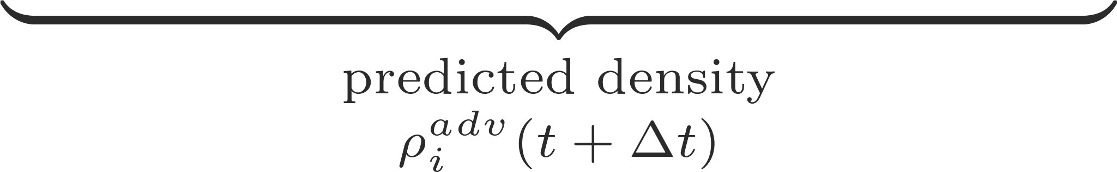
IISPH - Method
Split velocity
  Intermediate velocities without pressure force
Discretization

Slide 35
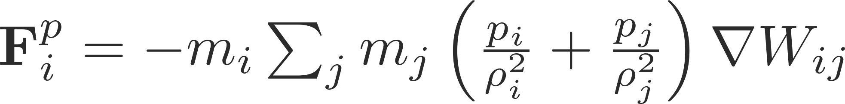
IISPH – Pressure Force
Momentum preserving formulation
Linear system with unknown pressure values
Properties
  A particle has up to 40 neighbors
  Approximately 40*40 non-zero coefficients per equation

Slide 36
IISPH - Implementation
Relaxed Jacobi
  Matrix-free implementation
  Implicit computation of non-diagonal entries
  Seven scalar values per particle are stored
  Two loops over set of particles per iteration
  Fully parallelized
  Fast convergence

Slide 37
IISPH - Properties
Efficiency
  Low number of iterations, typically between 5-15
  Iterations are cheap to compute
  Pressure solver outperforms previous schemes by factor 7
Plausibility
  Enforces compression of less than 0.1%
Robustness
  Handles larger time steps than previous schemes
  Adaptive time-stepping is easy

Slide 38
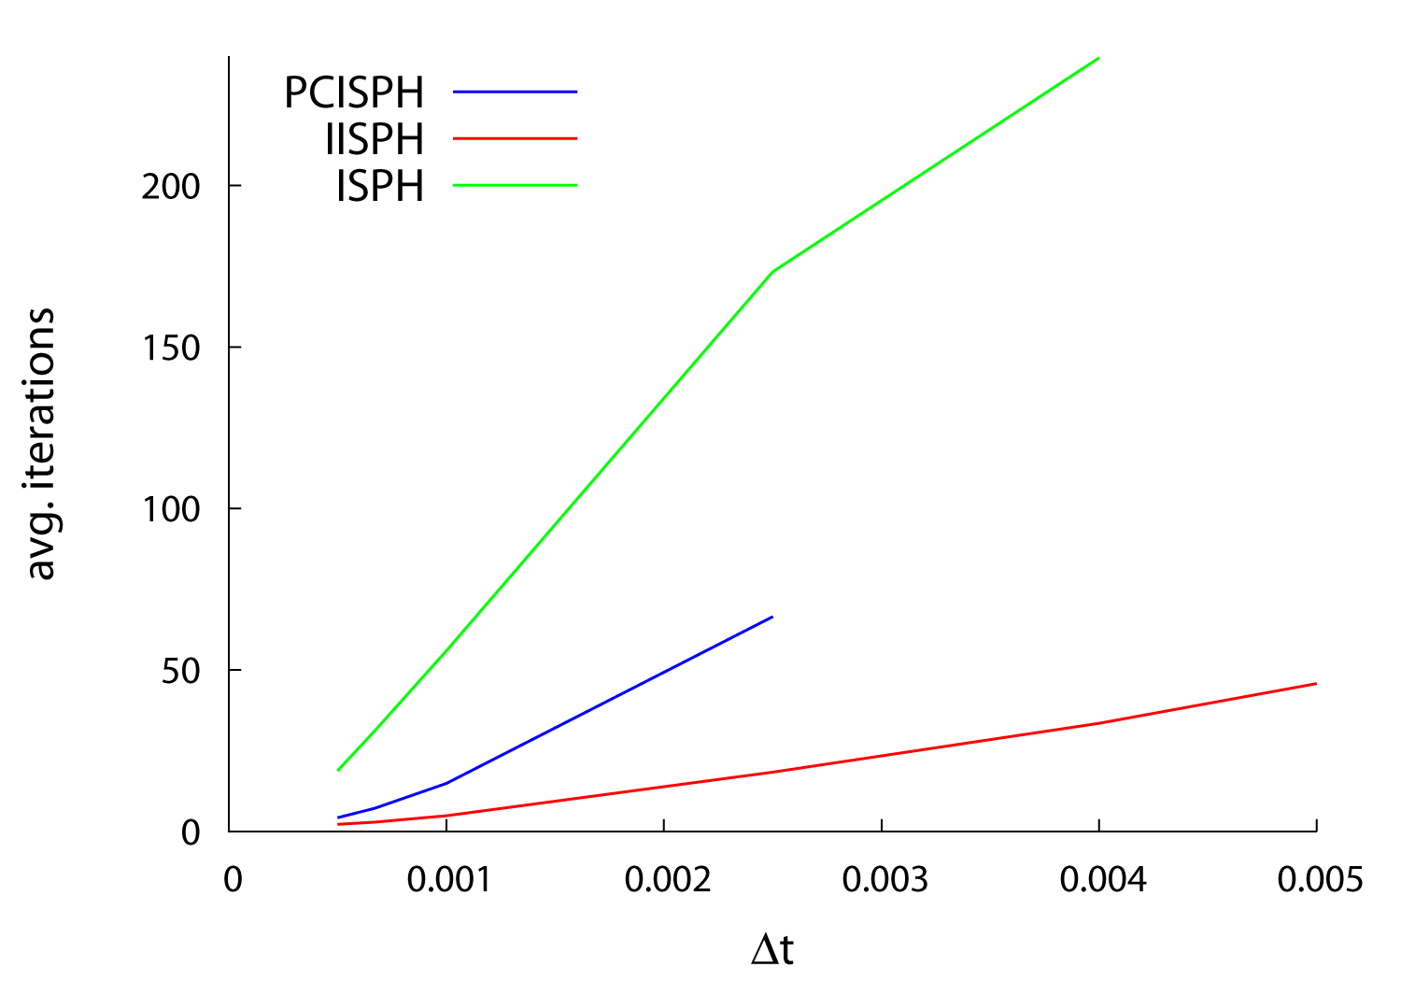
Comparison of Iterative Methods
Avergage number of iterations to enforce volume preservation with an error of 0.1%

Slide 39
Topics / Research Challenges
SPH fluid solver
Neighborhood query
Incompressibility / pressure computation
Boundary handling
Multiple phases
Multi-resolution
Surface reconstruction and rendering

Slide 40
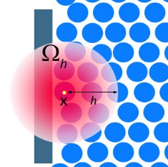
SPH Approximation at the Boundary
Particle deficiency at the interface
  Results in discontinuities
  Large pressure gradients
Solution:
  Sample boundaries with particles to approximate field variables

Slide 41
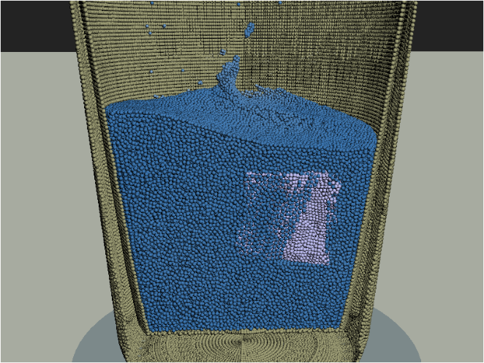

Strategies
Sampling
  Pre-sampling, e.g., [Keiser06, Solenthaler07, Akinci12, Schechter12]
  Online sampling, e.g., [Hu06]
Field approximation of boundary particle
  Interpolate, e.g., [Solenthaler07, Ihmsen10]
  Mirror, e.g., [Akinci12, Schechter12]
Force computation
  Penalty forces, e.g., [Müller04, Lenaerts08]
  Direct forcing, e.g., [Becker09]
  Pressure-based, e.g., [Solenthaler07,Akinci12]

Slide 42


Sampling of Arbitrary Meshes
Uniform sampling not always possible
Particle spacing must not be larger than smoothing length
Correct particle volumes in oversampled boundary regions [Akinci12]
Mirror fluid particle‘s rest density onto rigid particle to get mass contribution
Example: adapted density computation

Slide 43

Sampling - Mass Contribution

Slide 44
Topics / Research Challenges
SPH fluid solver
Neighborhood query
Incompressibility / pressure computation
Boundary handling
Multiple phases
Multi-resolution
Surface reconstruction and rendering

Slide 45

Multiphase Fluids
Particles offer the advantage that the free surface and the interface between two fluids is sharply defined
[Müller 05, Tartakovsky05, Hu06, Solenthaler08, Schechter12]
Liquid-liquid interface
Liquid-air interface
[Solenthaler08]
[Schechter12]

Slide 46



Particle Attributes
Particles carry attributes individually
  Mass
  Rest density
  Viscosity coefficient
  Color attributes
  Temperature
Buoyancy emerges from individual rest densities V_{i}^{fluid1} = V_{j}^{fluid2}
Diffusion of concentration, temperature
[Müller05]

Slide 47

High Density Ratios
[Solenthaler08]

Slide 48
High Density Ratios
Adapted SPH
  Stable simulations despite high density ratios
  We need full control over behavior
Standard SPH
  Cannot handle discontinuities at interfaces
  Results in spurious and unphysical interface tension
  Large density differences lead to instability problems
[Solenthaler08]

Slide 49
Interface Problems
Desired density field
SPH density field
Particle density
Problems near interfaces where rest densities and masses vary
Falsified smoothed quantities
Adapted density
Apply the same idea to all forces!
[Solenthaler08]

Slide 50


No Artificial Tension Forces
[Solenthaler08]

Slide 51
Liquid-air Interface
Density deficiency at the free surface due to lack of neighbors
-> Surface tension artifacts, clustering in spray
[Schechter12]
Air particles solve these problems, at the cost of higher memory consumption and computation costs

Slide 52
Liquid-air Interface
[Schechter12]
Air particles solve these problems, at the cost of higher memory consumption and computation costs

Slide 53
Trapped Air
Similar to [Schechter12], [Müller05] dynamically sample parts of the free surface with air particles -> trapped air
[Müller05]
High density ratios are challenging; simulate phases separately [Ihmsen11] and couple them via drag force
[Ihmsen11]

Slide 54
Topics / Research Challenges
SPH fluid solver
Neighborhood query
Incompressibility / pressure computation
Boundary handling
Multiple phases
Multi-resolution
Surface reconstruction and rendering

Slide 55

Motivation for Adaptive Spatial Discretization
Many particles are needed to get the desired visual quality
Computational cost depends linearly on the particle number
Idea: Allocate computing resources to interesting regions
3K particles
3M particles
30M particles
[Müller03]
[Solenthaler09]
[Ihmsen13]

Slide 56






Criteria
High resolution in regions of interest and low resolution otherwise
Near the surface
Near the interface
Object interaction
[Horvath13]
[Solenthaler11]
[Solenthaler11]
Distance to Camera
View frustum
[Horvath13]
[Solenthaler11]

Slide 57
Approaches
Dynamic particle refinement
[Desbrun99, Adams07, Orthmann12]
Multi-scale methods
[Solenthaler11, Horvath13]
[Adams07]
[Solenthaler11]
1 simulation with differently sized particles
2 (or multiple) coupled simulations, each with equally sized particles

Slide 58
Dynamic Particle Refinement
Dynamically split and merge particles
Reproduce field quantities
Symmetric visibility
[Desbrun99]
Smooth size transition

Slide 59
Dynamic Particle Refinement
Dynamically split and merge particles
[Adams07]

Slide 60





Field Discontinuities
Supporting incompressibility increases the problems of field discontinuities
-> shocks, smaller time steps
Non-continuous sampling over time introduces large errors
1
t
[Orthmann12]

Slide 61




Field Discontinuities
Supporting incompressibility increases the problems of field discontinuities
-> shocks, smaller time steps
Non-continuous sampling over time introduces large errors
Smooth temporal blending of resolution levels [Orthmann12]
blend operator
1
t
[Orthmann12]

Slide 62


Field Discontinuities
Supporting incompressibility increases the problems of field discontinuities
-> shocks, smaller time steps
Non-continuous sampling over time introduces large errors
Smooth temporal blending of resolution levels [Othmann12]
Temporal blending
Reference solution
Resolution difference is limited
[Orthmann12]

Slide 63



Resolution Differences
Base resolution
2x resolution
-> 8x more particles
4x resolution
-> 64x more particles

Slide 64
Multi-scale Methods
Allow larger resolution differences
Avoid splitting / merging and thus field discontinuities
Use separate but coupled simulations for each level -> m^{level}, h^{level} const
Two-scale approach [Solenthaler11]
[Solenthaler11]

Slide 65

Multi-scale Methods – View Frustum
[Solenthaler11]

Slide 66


Extended to Multi-scale
Multiple resolution levels
Combined criteria
[Horvath13]
[Horvath13]

Slide 67

Extended to Multi-scale
Multiple resolution levels
Combined criteria
[Horvath13]
[Horvath13]
Speed-up:
[Adams07, Solenthaler11]: 3-7x
[Horvath13]: 3-12x
All previous work: less memory

Slide 68
Topics / Research Challenges
SPH fluid solver
Neighborhood query
Incompressibility / pressure computation
Boundary handling
Multiple phases
Multi-resolution
Surface reconstruction and rendering

Slide 69



Motivation
Smooth Surfaces
Efficient Reconstruction
Combined Volume Rendering
Notes:
In recent years, mesh-free methods have become one of the favorite techniques for fluid simulation.
However, with ease of simulation comes the challenge of rendering at a reasonable amount of time.
In total we can summarize the following challenges:
We want smooth surfaces while preserving fine details.
Usually, we care about efficient sampling, e.g. for interactive applications.
Also combined rendering for surface and volume effects becomes of interest, both memory and time efficient.

Slide 70
Outlook
Scalar field functions
Polygonalization and particle skinning
Explicit surface tracking
Direct surface rendering
Volume rendering
Notes:
The “surface reconstruction & rendering” part of our talk is outlined as follows:
- We first discuss the most prominent scalar field functions as favoured in Graphics Literature
- Secondly we will examine techniques for reconstructing smooth surfaces.
- Then we present popular rendering techniques
- Finally we conclude with techniques for combined volume and surface rendering.

Slide 71






Scalar Field Functions
General approach: Surface = Iso-surface of scalar field function
Metaballs [Blinn82]: Superimposed potential function located at particles → yields blobby surfaces
Color field [Müller03]:
  Color field ≈ 1 in bulk and 0 in air
  Surface normal as color field gradient
  Disadvantage: Bumpy surface
Distance to center of mass [Zhu05]:
  Define level set function
    Center of mass
    using larger radius
  This approach yields smoother results
Adopted from [Adams07]
Notes:
Before applying a specific rendering technique, the first step is to identify the fluid’s surface.
In contrast to Eulerian simulation, where the zero-level set of a signed-distance function is propagated with the fluid flow, in Lagrangian simulations the fluid surface is defined by superimposing kernel functions of particles to define scalar field functions.
In the literature there are mainly two ways to define those field functions: Using a color gradient function or a point-to-center distance function.
Gradient function over the color function naturally reveal surfaces
However, irregular particle distributions often result in bumpy surfaces
Smoother surfaces are achieved using the following point-to-center distance function first proposed by Zhu and Bridson in 2005. (quasi constant radius d(x))
As can be seen in the image of Adams et al., a distance function is given by the distance of the position in question x to the center of the local mass distribution a(x), d(x) is the average particle-to-surface distance.
In that formulation, both a(x) and d(x) are computed by averaging positons and approximate distances of neighbouring particles.
\phi(x)=0 then describes points on the surface.
However, still the original formulation of Zhu and Bridson results in artifacts in concave regions.
We will now investigate algorithms to achieve even smoother surfaces.

Slide 72




Particle-to-Surface Distance
Improved particle-to-surface distance function [Adams07]:
  Level set function with varying distance
    Average distance to surface (from prior step):
Surface projection using approximate particle-to-surface distances
  Binary search along gradient
  Surface particle, if surface within radius r_{i}
[Adams07] (100K ptcl; several sec on Intel Pentium D)
Notes:
Another smoothin technique is based on redistancing particles for rendering:
In the approach of Adams et al., particles carry approximate particle-to-surface distances which are updated over time.
For particles near the surface, footprints on the surface are computed.
Therefore, surface particles are projected to the zero level set using a binary search along the ray segment from x_i to x_i + r_i \nabla \phi(x_i).
During iteration distance values are re-evaluated at s=0,s=r_i/2 and s=r_i, where r_i is the particle’s support radius.
Pro: due to redistancing bumps in the particle structure are smoothed
Cons: Requires tracking and updating of particle distances

Slide 73



Scalar Field Functions: Comparison & Problems
Comparison:
  Metaballs [Blinn82]
  Constant distance
  R [Zhu05]
  Particle-to-surface
  distance d(x) [Adams07]
Issues with the center of mass in concave regions :
  Erroneously parts outside of the fluid volume
  Very sensitive to changes of the query point
coarsening
refining
[Adams07]
Errors in concave regions [Solenthaler07]
Notes:
- In combination with larger smoothing radii, the center of mass here given by \overline(r) can erroneously end up outside of the viewing volume.
- By observation the center of mass \overline{r} changes much faster than the query point r.

Slide 74





Scalar Field Function: Removal of Artifacts
Analysis of gradient of mass center [Solenthaler07]
  Observation: Strong variation of center of mass at artifacts
  Solution: Weight distance function according to eigenvalue of
Alternative approach [Onderik13]:
  Use normalized iso-density instead of EV
Decay function [Solenthaler07]
Comparison of [Solenthaler07] (left) and
[Onderik13] (right) (14k ptcl, < 1 sec, Intel Core 2 Duo)
Transfer function [Ondrik13]
Notes:
The idea presented by Solenthaler et al. is to investigate the largest eigenvalue EV_{\max} of \nabla a(x).
\nabla a(x) is 3x3 matrix describing the local change of the center of mass.
A distance based decay function then maps EV_{\max} to values of f via user defined values t_min and t_max.
Alternatively, one can also use a decay function based on particle positions as presented by Onderik et al. [OCD13].
Using decay functions is a prominent solution found in many surface renderings, such as [SP09] and [AIAT12].
Pro: The approach only requires an additional decay function

Slide 75





Scalar Field Functions: Anisotropic Kernels
Goal: Smooth and feature preserving surface reconstruction
Anisotropic kernels based on covariance matrix over local particle neighborhoods [Yu10].
Scalar field defined via using
in order to define anisotropic kernel
Anisotropic kernel [Yu13]
Particle and surface rendering [Yu13]
(24K ptcl; <10 sec on Intel Core 2 Duo)
Notes:
In the approach of Yu and Turk [YT13] the implicit function is defined using anisotropic instead of isotropic smoothing kernels.
- The method relies on repositioning and stretching SPH kernels according to the spatial distribution of particle neighborhoods.
- This spatial distribution is determined using covariance matrix.
The inverse G of the Singular Value Decomposition of C then is used to stretch the distance vector r in the anisotropic kernel W(r,G).
Special cases: deficient neighborhood → C=Id
Beside for direct rendering this technique has been successfully applied for interactive screen spaced approaches [Gre10], [MM13].
Macklin: screen space & anisotrop kernels

Slide 76


Marching Cubes Reconstruction
Surface Vertex
Extraction
Scalar Field
Computation
Marching Cubes
Decimation &
Subdivision
Polygonal iso-surfaces w.r.t. scalar function using Marching Cubes
Idea: Optimization of Marching Cubes on GPU [Akinci12a, Akinci12b]
  Store grid nodes in a narrow band at surface reduces complexity to O(n²) [Akinci12a]
  Specific handling of “double layers”
  Post-processing [Akinci12b]:
    Decimation: QEM mesh reduction
    Refinement: Loop subdivision scheme
Decimation & Subdivision [Akinci12b]
Initial surface [Solenthaler07] (left), after decimation (middle)
and subdivision (right) [Akinci12b] (60k ptcl, 3.3 sec, Intel Xeon X5680)
Notes:
The rendering pipeline proposed by [AIAT12] consists of 4 steps:
Extracting surface vertices, e.g. grid points in the AABB of size 4r around a surface particle → O(n²) statt O(n³)
Identification of contributing particles: Details: Double Layer Problem
Scalar value computation
Marching cubes reconstruction
E) Decimation (QEM) and Subdivision (Loop); Details: Decimation and Subdivision; Goal: improved representation of smaller surface details, reduction of bumps in flat regions,
Pro: High Quality Smooth Surfaces.
Cons: Requires expensive polygonalization step.

Slide 77








Particle Skinning with Energy Minimization
Idea: Find minimal thin plate energy surface between minimal and maximal surface [Bhattacharya11].
Sample potential function of particles onto regular grid
Constrained thin plate optimization with initial
  Constraint:
Constrained surface
(red) between
and
Amarillo with 0, 20 and 100 iterations [Bhattacharya11]
Notes:
The approach seeks a smooth surface that is constrained to lie between two surfaces.
Both surfaces are defined by minimum and maximum distance \phi_{\min} and \phi_{\max} sampled on a grid.
The constrained optimization approach then tries to minimize a thin plate energy using a fixed number of iterations
Pro: Yields smooth surfaces
Cons: Often eliminates splashes; no timings!!!
No shrinkage compared to Laplacian smoothing
We now come to rendering techniques which use the previously discussed scalar field functions.

Slide 78






Explicit Surface Tracking
Mesh
Initialization
Mesh
Advection
Mesh
Refinement
Mesh
Projection
Topological
Changes
Idea: Attach & track an explicit mesh at the fluid surface [Yu12]
Initial mesh using anisotropic kernels [Yu10] and MC reconstruction
Mesh advection: Normalized velocities at mesh vertices v_{i}
Mesh refinement using standard split-merge approach
Mesh vertices are projected onto iso surface [Adams07]
If projection fails, i.e.
  Topological merge if v_{i} interior ( ) and split else ( )
[Yu12] (29k ptls, 41s surface tracking, 24s surface reconstruktion, 2x Intel Xeon E5620)
Notes:
All Images and Pipeline based on the work of Yu et al. [Yu12]:
General: track mesh properties like color, TexCoord etc.
Creation of an initial triangle mesh (anisotropic kernels [Yu10])
Advect mesh vertices according to particle velocities (SPH velocity, nomalized)
Adaptive Splitting and Merging of Edges, whenever edges are too long or too small (0.5*l_avg <= l_curr <= 2 l_avg)
Projection of mesh vertices onto implicit surface [Yu10] as defined by the scalar field function (along normal within particle radius)
Perform topological changes (detection: projection fails) if the fluid merges or splits
Pro: Smooth representation. Accurate tracking of surface information, like textures.
Cons: Requires remeshing of triangle mesh, Cannot accurately handle drops and splashes.

Slide 79





Direct Rendering
Surface Particle
Extraction
Scalar Field
Computation
Isosurface
Raycasting
Idea: Project surface particles onto grid and use iso-surface raycasting [Goswami10]
Extraction of surface particles similar [Zhu05] (distance to center of mass), but only masses w/o kernel weighting
Scalar field computation uses 3D splatting in
grid
  Transfer function defines relevant distance
  values
  Per grid vertex scalar value
Raycasting with normals computed on grid
Isosurface raycasting
Distance computation on small
band around surface particles
PovRay rendered results [Goswami10] (250k pctl)
Notes:
Pipeline based on [GSSP10], but similar [ZSP08,FAW10]:
Extraction of Surface Particles (distance to center of mass, similar [Zhu05], but only masses, no kernel weighting)
Distance Field Generation for which band of relevant particles is defined by transfer function (3D splatting in grid with comparable same resolution of 64³; take minimal distance)
Raycasting ray isosurface intersection with normals computed on grid via central differences
Pro: Avoiding expensive polygonalization step enabling interactive renderings
Cons: Often yields bumpy surfaces

Slide 80




Screen-Space Rendering
Depth Map
Rendering
Screen Space
Smoothing
Compositing & Lighting
Idea: Splat particles as spheres onto image plane apply depth map smoothing [van der Laan09]
Render particles and store screen-space depth and normal values
Screen-space smoothing (“curvature flow”)
  Evolve depth according to mean curvature using
  Apply smoothing iteratively
Final rendering using compositing
Gaussian smoothing (left) vs. curvature
flow (right) [van der Laan09]
(64k pctl, 18.1 ms (bilateral), 50 ms (curvature flow 100 it), GF8800 GTS 512)
[Macklin13]
Notes:
Pipeline based on [vdLG09]:
Depth map generation by rendering front-most particles as spheres (Depth Test Graphics Hardware)
2D Image-based normal smoothing filter (depth correction according to mean curvature 2H=\nable\cdot \vec n; \PD zt = H → Euler → iterative
Compositing of the final image
Pro: Due to 2D image-based smoothing enabling fast interactive renderings
Cons: Often yields smoothing artifacts at fluid boundaries/flow features, Efficiency is bound to Hardware-based Rasterization Pipeline

Slide 81


Volume Rendering
Perspective
Mapping
Particle
Slicing
Surface
Rendering
Idea: Additionally visualize quantity distribution within bulk
Approaches for SPH volume rendering
  Texture slicing based on a view-aligned perspective grid [Fraedrich10]
  Raycasting on a object aligned octree hierarchy [Orthmann10]
Texture slicing on perspective grids [Fraedrich10]:
  Perspective mapping ensures a quasi regular sampling along rays
  Particle hierarchy allows for “particle size approx. cell size”
  Particle slicing samples particle contributions onto grid
  Final rendering via standard texture slicing using front-to-back slabs
Perspective Mapping
Particle Slicing
Notes:
Pipeline base on [FAW10], but [FGE10] similar:
Space-Subdivision of Simulation Domain
GPU-based particle slicing (2D texture stack @ screen resolution) using perspective mapping (density values); s_min/max texture index; h adopted to distance (hierarchical structuring)
Compositing of Texture Slices and Surface Rendering using gradient computation in perspective texture slices
Pro: Enables Interactive Renderings
Cons: Efficiency due to Rasterization Hardware. Yields Bumpy Surfaces.

Slide 82


Combined Volume Rendering
Particle-to-Cell
Mapping
Volume
Sampling
Surface
Rendering
Raycasting on a object aligned octree hierarchy [Orthmann10]
  Particle-to-cell mapping & hierarchy building per frame
  Efficient traversal of OA octree using various caches
[Fraedrich10]
(2.5M pctl, 152 ms @ 512² res, 676 ms @ 1024² res,
Intel Core 2 Duo 2.4 GHz + NV GTX 280)
Similar to [Orthmann10]
(2.4M pctl, 1024² res, 2s object space hierarchy,
870 ms perspective grid, Nvidia GTX Titan
Notes:
(Perspective) Particle-To-Cell Mapping
Volume Sampling along viewing rays using caches
Surface Rendering, either Gradient Computation or any other surface rendering technique
Pro: Not bound to GPU, Enables high-quality surface renderings
Cons: Interactive Frame-rates only for smaller numbers of particles

